Slide 1
Significant Weather Events
Chapter
31
Learning outcomes: 1.7, 1.8

Slide 2
At the end of this chapter, you will be able to:
31.1 Identify the two main weather systems.
31.2 Describe the formation and behaviour of anticyclones.
31.3 Describe the formation and behaviour of depressions.
31.4 Explain hurricanes as significant weather events.

Slide 3
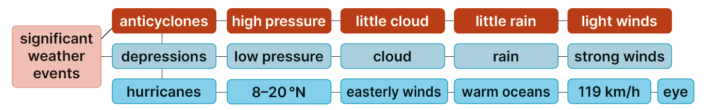
Keyword connections

Slide 4
31.1 Identify the two main weather systems.
Pre-test
Complete Question 1 on page 173 of your Skills Book.
At the end of this topic, review your answers. Which did you guess correctly/incorrectly?

Slide 5
31.1 Identify the two main weather systems.
There are two main weather systems on Earth: anticyclones and depressions.
Weather systems are shown on maps using isobars.
An isobar is a line on a weather map connecting places of equal atmospheric (air) pressure.
Isobars work a little like contours on an OS map.
Isobars never cross.
Close isobars show higher wind speeds.
Wide isobars show lower wind speeds.
The numbers printed on the lines show the air pressure in millibars. The gap between isobars is always 4 mb.

Slide 6
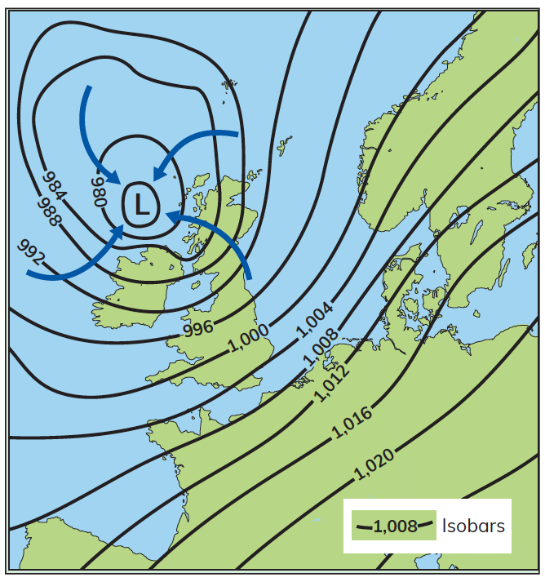
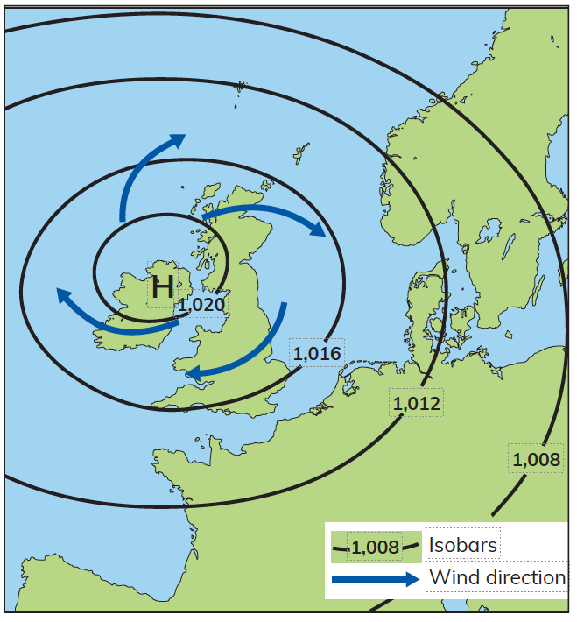
31.1 Identify the two main weather systems.
Map A
Map B
Complete the Activity on page 388 of your Textbook.

Slide 7
Air Masses.
An air mass is a body of air with its own temperature, pressure, and humidity level.
Air masses can effect the weather of the countries they pass over.
Many different air masses meet over Ireland so our weather changes a lot.
There are 4 different air masses which effect Ireland’s weather.
1. Polar Air Masses
2. Continental Air Masses
3. Tropical Air Masses
4. Maritime Air Masses

Slide 8
Comparison high and low pressure
High (Anticyclone)
Low (cyclone/Depression.
Roughly Oval.
Very large.
Isobars. Far apart bringing calm conditions.
Pressure is highest at centre.
No Clouds. Dry Weather.
Oval.
1000km.
* Isobars are close together bringing windy conditions.
Pressure is lowest at centre.
Cloudy and constant heavy rain.

Slide 9
31.1 Identify the two main weather systems.
Go to Section 31.1 on page 173 of your Skills Book.

Slide 10
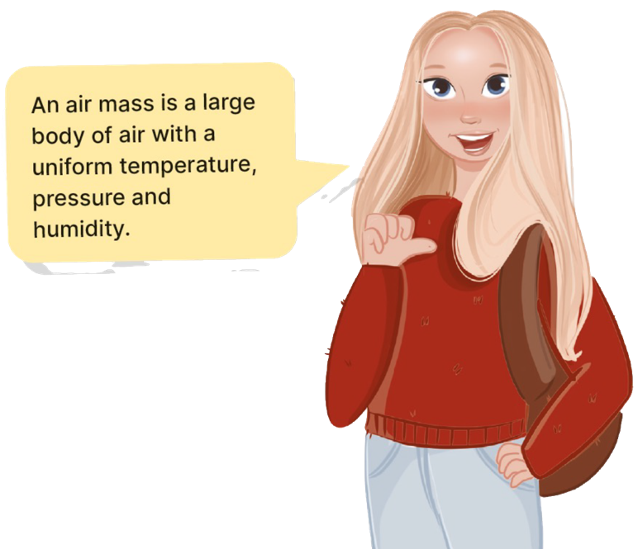
31.2 Describe the formation and behaviour of anticyclones.
An anticyclone is an area of high-pressure air mass. Anticyclones are also called ‘highs’.
It is associated with falling (descending) air.
The high pressure occurs at the centre of the anticyclone. As the air falls (descends), it gets warmer.
The warmer air absorbs moisture, so clouds do not form.
Air moves clockwise out from the centre of the anticyclone to areas of lower pressure that surround it. This causes light winds.
These winds travel in a clockwise direction in the northern hemisphere. Winds in an anticyclone are gentle.
An anticyclone is shown on a weather map by the letter H.

Slide 11
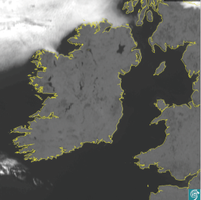
31.2 Describe the formation and behaviour of anticyclones.
Weather behaviour in an anticyclone
Anticyclones bring dry, settled weather and clear skies.
In anticyclones, the descending air warms up. Condensation does not occur so there is little cloud. In summer, anticyclones bring hot and sunny weather.
In winter, lack of cloud cover causes nights to be cold and frosty. As the air warms up, it absorbs moisture, so anticyclones bring dry weather.
Winds are light, because as the air falls, it is less affected by the rotation of the Earth.

Slide 12
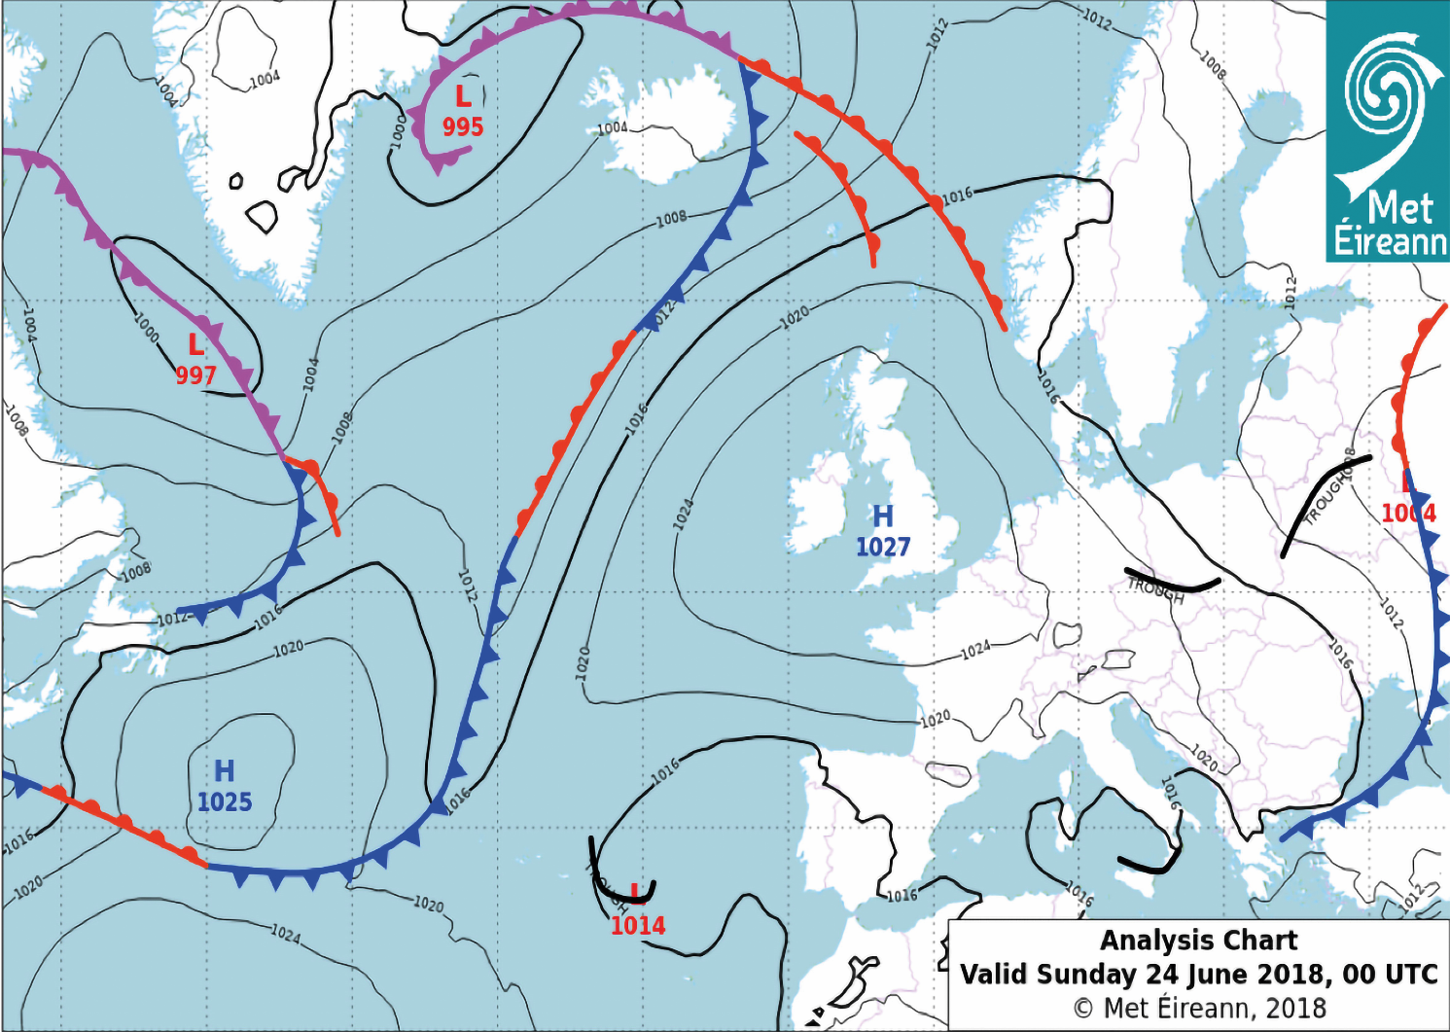
31.2 Describe the formation and behaviour of anticyclones.

Slide 13

31.2 Describe the formation and behaviour of anticyclones.
1. What is another name for an anticyclone?
2. In what direction does air move in an anticyclone?
3. What symbol is used to show high pressure on a weather map?
4. What sort of weather does an anticyclone bring?
5. How are isobars in an anticyclone spaced on a weather map?

Slide 14
31.2 Describe the formation and behaviour of anticyclones.
Higher-order questions 1
1. What is a heatwave?
2. Would it be desirable to have a permanent high-pressure zone over Ireland in winter? (Hint: It would mean we would have less wind and rain in winter.)
3. How do high-pressure air masses form?

Slide 15
31.2 Describe the formation and behaviour of anticyclones.
Go to Section 31.2 on page 174 of your Skills Book.

Slide 16
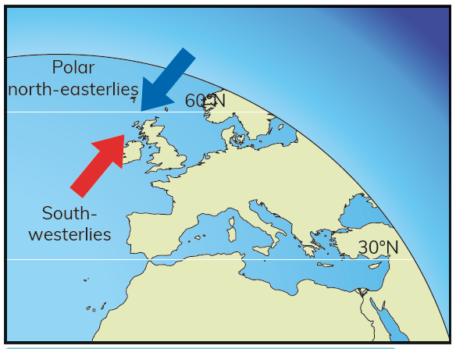
31.3 Describe the formation and behaviour of depressions.
Depressions are low-pressure air masses.
They are Ireland’s most common weather system.
A depression is also known as a cyclone, or a low.
They can last about 24 hours from beginning to end.
They bring frontal rainfall.
Warm air passes over the North Atlantic Drift, travelling from the south-west.
It meets cold air from the north-east.
Where the warm air meets the cold air, there is a front.
A front is the boundary between the warm air and the cold air.

Slide 17
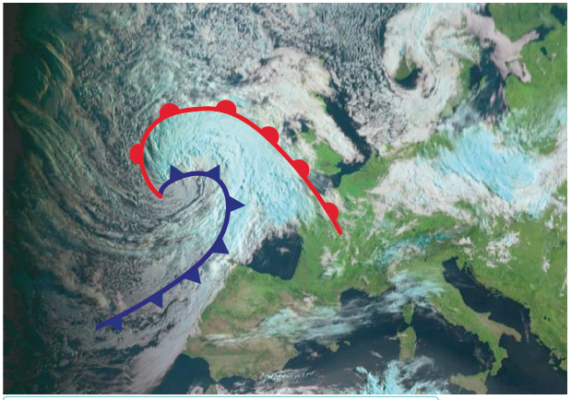
31.3 Describe the formation and behaviour of depressions.
When the two air masses meet, the cold air wraps around the warm air.
The warm air rises upwards and cools.
Cooling causes condensation, so clouds form.
This gives the depression its characteristic swirl of cloud.
The whole weather system moves east at the same time as the air mass swirls.
Rainfall occurs along the fronts.
In the photograph, the blue line shows the cold front and the red line shows the warm front.
The cold front is constantly chasing the warm front, and both swirl anticlockwise into each other.

Slide 18
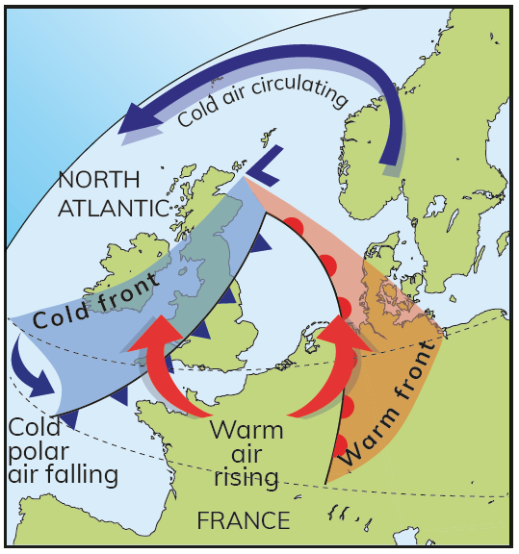
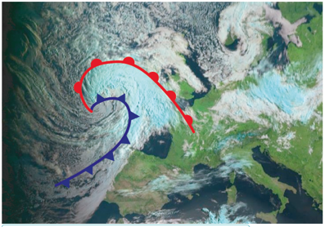
31.3 Describe the formation and behaviour of depressions.
A cold front is shown on a weather map using a blue line and triangles facing the direction in which the cold air is moving.
A warm front is shown on a weather map using a red line and semicircles facing the direction in which the warm air is moving.
Air pressure is lowest at the centre of a depression.
Low pressure is shown on a weather map with the letter L.

Slide 19
31.3 Describe the formation and behaviour of depressions.
The formation of depressions
Depressions form as a result of warm air being forced to rise above cold air.
The warm air mass is light, so it expands and rises.
The warm air pushes against the cold air and slowly rises over it. The warm air circulates anticlockwise into the centre of the low and rises.
Over a period of a few hours, the cold air forces a wedge or ‘sector’ of warm air to rise. The fronts are marked by large areas of cloud. This is because where the warm air meets the cold air, condensation occurs and clouds form.
Over time, the cold front catches up with the warm front. Eventually, the warm air rises above the cold air, which circulates underneath.
As the warm air rises, it cools and condenses, producing persistent rainfall.

Slide 20
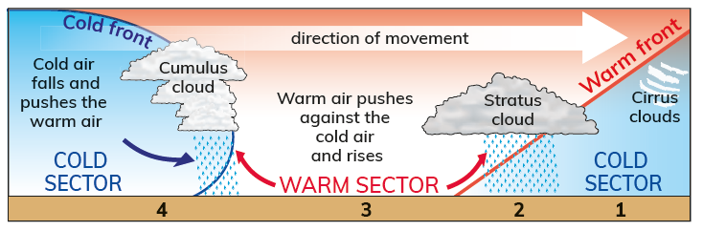
31.3 Describe the formation and behaviour of depressions.
Weather behaviour in a depression
Depressions bring cloudy, wet and windy weather as they pass over an area. The weather changes as a depression develops.
Before the depression arrives, there are cirrus clouds high in the sky.
As the warm front approaches, air pressure falls, stratus clouds fill the sky and continuous rainfall occurs.
In the warm sector, stratus clouds continue to form. These clouds trap heat and cause temperatures to rise slightly.
There can be occasional drizzle.
When the cold front passes over, air pressure increases, temperatures fall and cumulus clouds form, bringing blustery
showers.

Slide 21

31.3 Describe the formation and behaviour of depressions.
1. What is a ‘front’ in a depression?
2. How are fronts shown on a weather map?
3. What sort of weather do depressions bring?
4. What happens to the warm air mass in a depression?
5. Why does Ireland get a lot of depressions?

Slide 22
31.3 Describe the formation and behaviour of depressions.
Higher-order questions 2
1. Can depressions form in summer?
2. What happens when the cold front fully catches up with the warm front?
3. What do you predict is the combined effect of depressions passing over Ireland and the effect of the mountains on the west coast on rainfall?

Slide 23
31.3 Describe the formation and behaviour of depressions.
Go to Section 31.3 on page 175 of your Skills Book.

Slide 24
31.1 Identify the two main weather systems.
Go back to Question 1 on page 173 of your Skills Book.
What answers would you change?

Slide 25
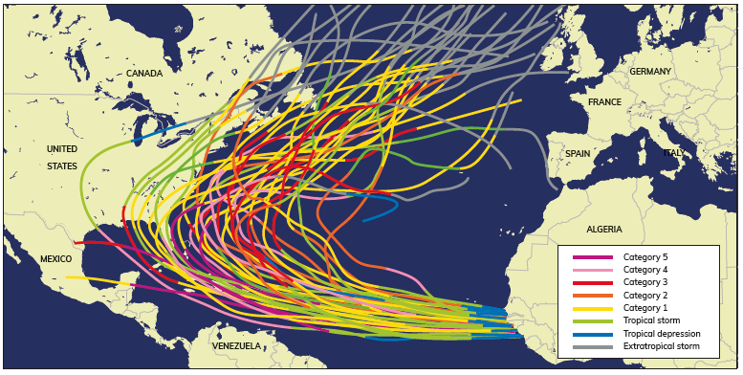
31.4 Explain hurricanes as significant weather events.
Hurricanes form in the Atlantic Ocean.
Hurricanes can be up to 1,000 km wide.
They cause huge waves and generate enormous volumes of rainfall.

Slide 26
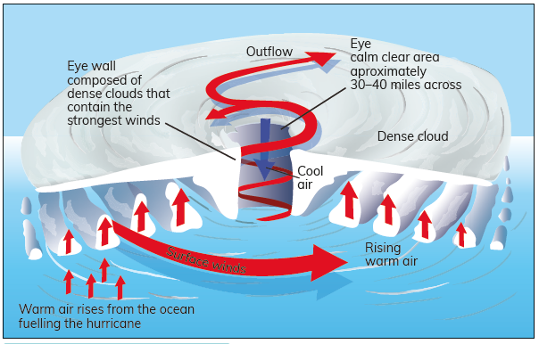
31.4 Explain hurricanes as significant weather events.
Formation of a hurricane
Hurricanes form off the coast of Africa
Between 8° and 20° north
When ocean temperatures reach 26°C or higher.
Air is drawn into the centre of a low-pressure zone.
The warm temperature of the ocean causes evaporation.
A tropical thunderstorm develops.
As the air rises, it cools and condenses, producing cloud.
Condensation releases more heat into the atmosphere. This increases the amount and speed of evaporation, which leads to further cooling and condensation.

Slide 27
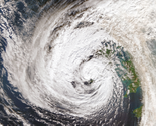
31.4 Explain hurricanes as significant weather events.
The cycle of condensation, heat, and evaporation repeats itself
The Coriolis effect makes the storm spin ever faster.
Once the storm reaches a speed of 119 km per hour, it is officially a Category 1 hurricane.
At the centre of the hurricane is the eye.
It is caused by denser air falling in the middle of the hurricane.
The edge of the eye is the eye wall. Wind speeds here can be over 250 km per hour.
The pattern of rising and falling air gives hurricanes the appearance of bands of circulating cloud.
As the hurricane moves across the ocean, it causes a storm surge to form.
This is a huge wave – over 8 m high – which can devastate coastal communities.
As hurricanes move north in the Atlantic Ocean, they lose energy and are eventually downgraded to extra-tropical storms.

Slide 28
31.4 Explain hurricanes as significant weather events.

Slide 29

31.4 Explain hurricanes as significant weather events.
1. Where do hurricanes form?
2. What makes hurricanes different to the depressions Ireland experiences?
3. When does a tropical storm become a hurricane?
4. Describe the path a hurricane takes after it forms.
5. What is an extra-tropical storm?

Slide 30
31.4 Explain hurricanes as significant weather events.
Higher-order questions 3
1. Why do hurricanes form so close to the equator?
2. Where do hurricanes get their energy from?
3. What happens when a hurricane runs out of moisture?

Slide 31
31.4 Explain hurricanes as significant weather events.
Complete the Exam Expert section on page 396 of your Textbook.

Slide 32
31.4 Explain hurricanes as significant weather events.
Go to Section 31.4 on page 176 of your Skills Book.

Slide 33
Assess your progress
Go to page 178 of your Skills Book and assess your progress.
31.1 Identify the two main weather systems.
31.2 Describe the formation and behaviour of anticyclones.
31.3 Describe the formation and behaviour of depressions.
31.4 Explain hurricanes as significant weather events.
Identify any gaps in your learning. Use the Rapid Revision on page 397 of your Textbook to jog your memory.

